Slide 1

SQL Server AG Monitoring and Troubleshooting
Karol Papaj

Slide 2









Our Partners
Notes:
If you think, that a SQL Saturday is a nice possibility to learn from and network with fellow SQL Server enthusiasts FOR FREE,
I just ask you one thing: Visit the sponsor booths and chat with the sponsors!
They are covering the expenses for each and every of you, with is around EUR 60 …

Slide 3
SQL Server AG Monitoring and Troubleshooting

Slide 4

Karol Papaj
SolidQ
SQL Server BI
SQL Server High Availability
SQL Server Relational Engine
kpapaj@solidq.com, @KarolPapaj

Slide 5

CREATING AG
Define replicas
Specify database(s)
Add listener

Slide 6

MONITORING
AG Dashboard

Slide 7

DONE.
REALLY?
What about RPO/RTO?

Slide 8
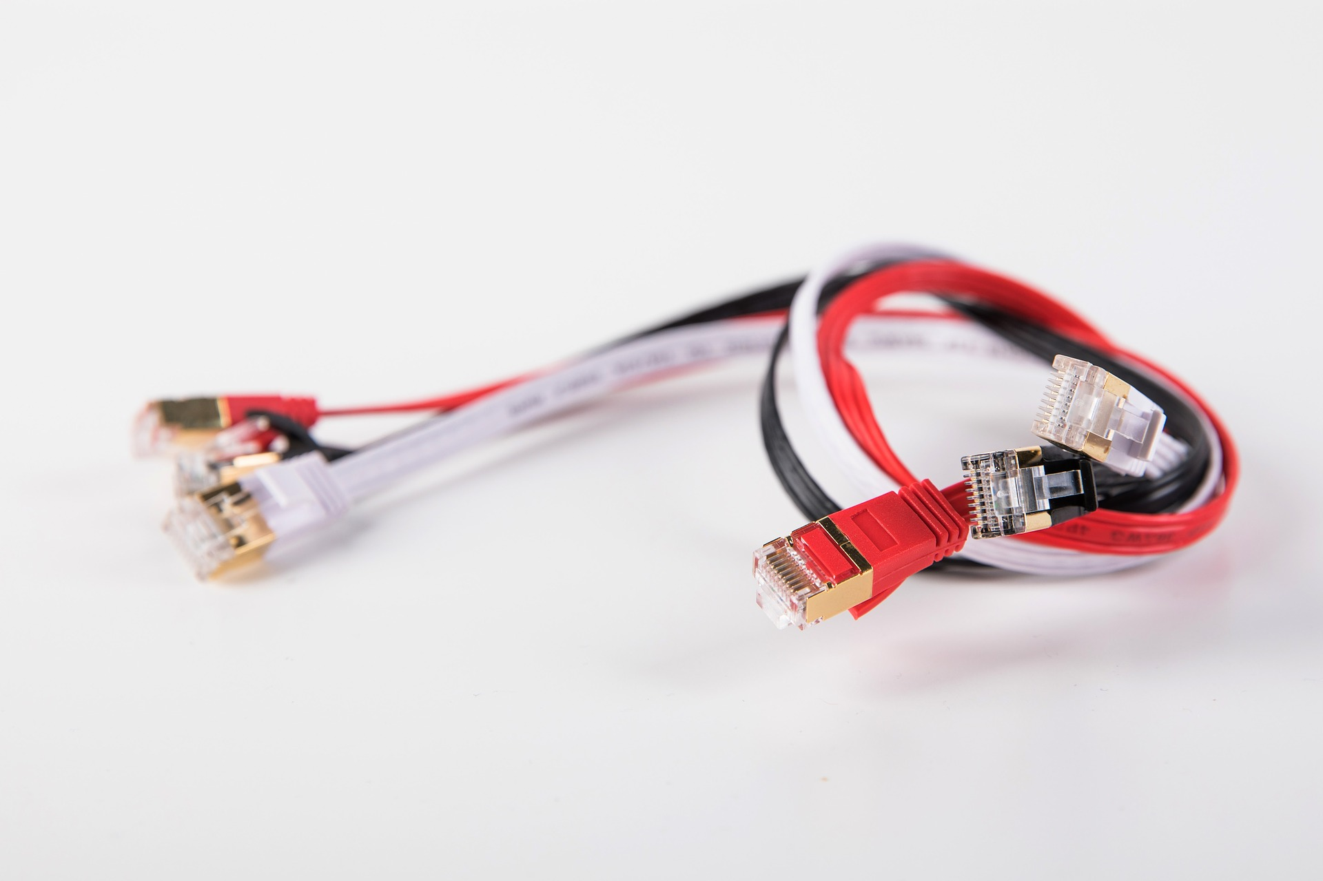
POTENTIAL
DATA LOSS
RPO
Symptoms:
(on primary)
Increasing log_send_queue size
Increasing T-log size
Increasing secondary_lag_seconds
Root Cause:
Slow network
Resource contention (on secondary)
Monitor:
Customize AG Dashboard
Customize Perfmon
Solution:
Increase Network Throughput
Add Resource / RG

Slide 9
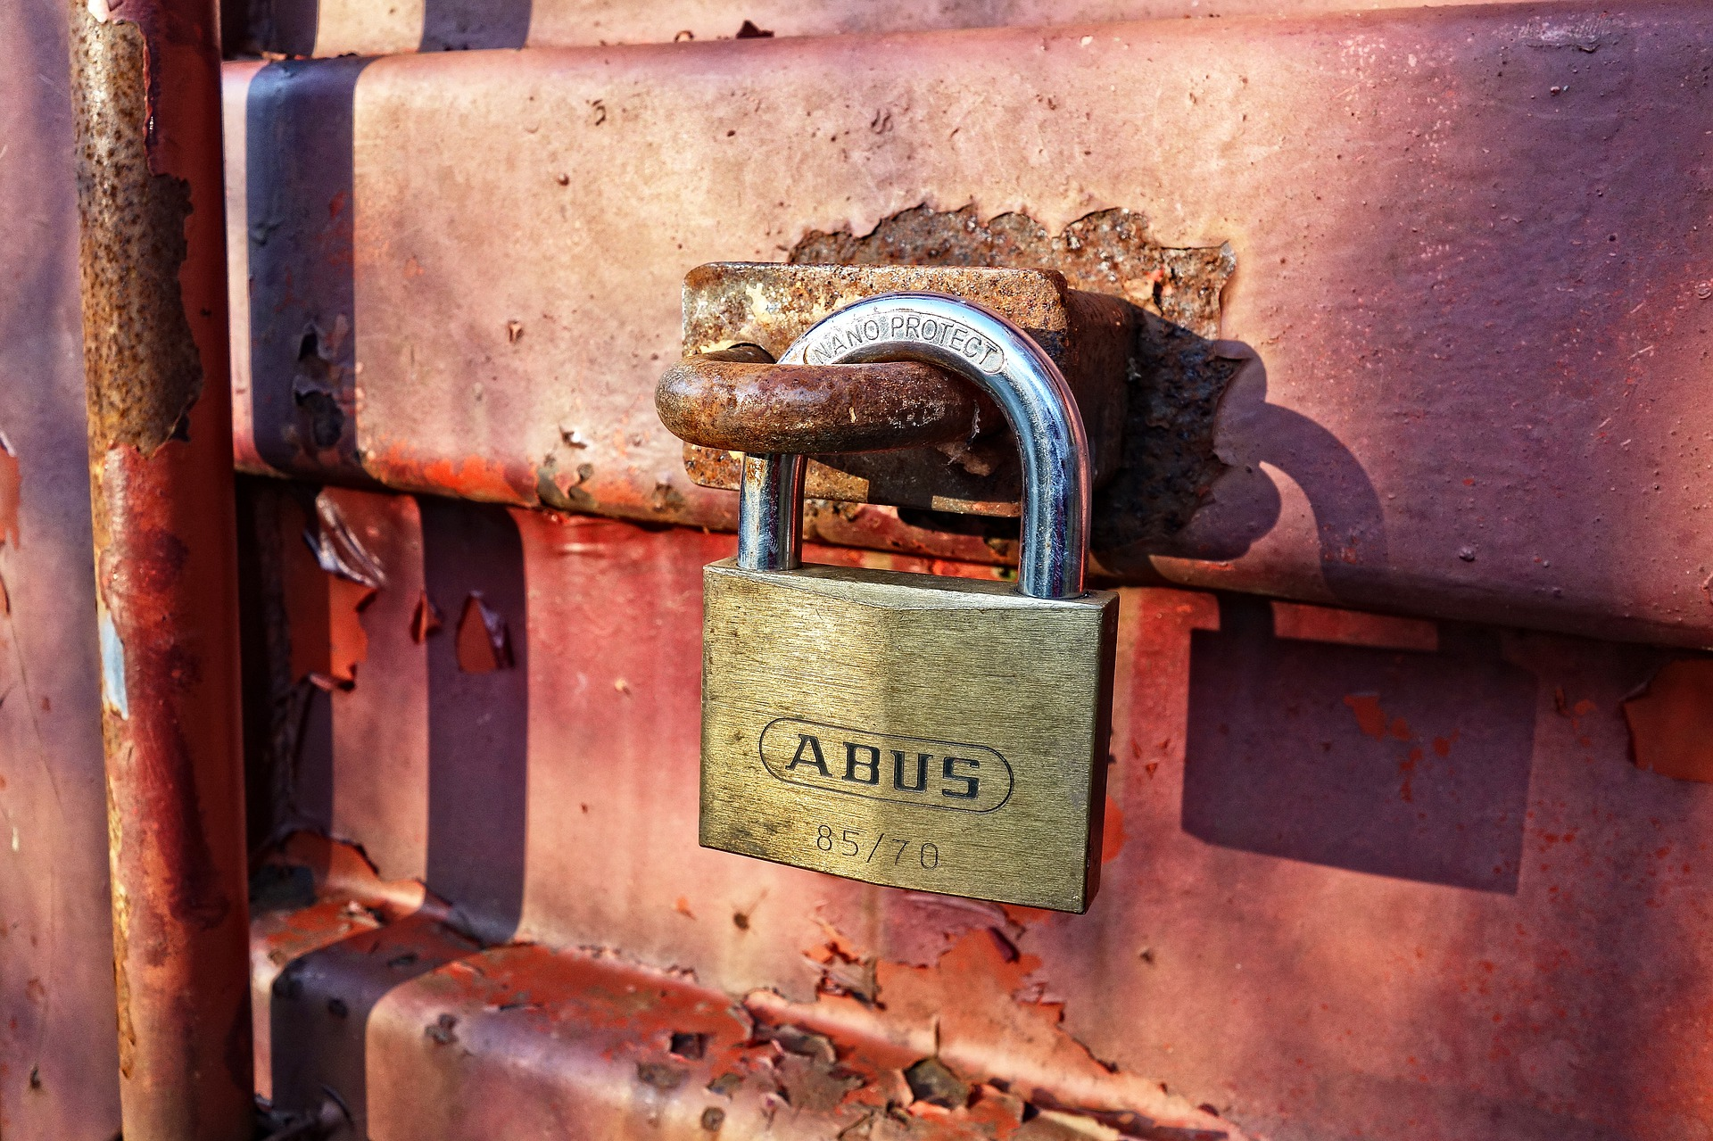
INCREASED FAILOVER TIME
RTO
Symptom:
Failover time is increased
AG is synchronized and no new data are visible on secondary replica
Root Cause:
REDO thread is blocked by long running reporting query on secondary replica
Lack of CPU/Disk resources
Monitor:
Customize AG Dashboard
Extended Events - XESmartTarget
Solution:
Kill reporting query

Slide 10

DO NOT RELY
ON DEFAULT
MONITORING
Extend AG dashboard configuration
Customize Perfmon
Customize Extended Events

Slide 11
QUESTIONS ?

Slide 12
THANK YOU !

